Slide 1
Introduction of Rstan
Gigi
zhe.zheng@yale.edu
08/10/2021
References and resources:
https://github.com/stan-dev/rstan
https://mc-stan.org/
https://www.r-bloggers.com/2019/01/an-introduction-to-stan-with-r/
https://www.slideshare.net/teitonakagawa/introduction-of-stan
https://epidemiology-stan.github.io/
https://mc-stan.org/users/documentation/case-studies/boarding_school_case_study.html

Slide 2
Content Table
What is Stan?
How to install Rstan?
Basic syntax in Stan
Example 1: a basic statistical model
Example 2: a basic mathematical model

Slide 3

What is Stan and Why Stan?
Stan is an probabilistic programing language to perform Bayesian inference with Hamiltonian Monte Carlo (HMC) written in C++.
Fewer iterations required
Build-in function for ODE
https://static1.squarespace.com/static/590c8f23d2b85789e7205e88/t/5ec549e91946263e2c8c84bf/1589987826950/BayesWorkshopDay3.pdf
Notes:
Stan required fewer iterations than JAGS and WinBUGS and may result in shorter running time compare with the other two bayesian inference methods;
Besides, stan has a built-in function for solving ordinary differential equations. It can help us measure the uncertainties of each parameter of interest in transmission dynamic models.

Slide 4
What is Stan?
A Stan program
defines a probability model
declares data and parameter variables (can be constrained)
draws from posterior distributions
calculates the log probability density function

Slide 5
How to install Rstan?
Before installing Rstan, you will need to configure C++ toolchain for your respective operating system
Windows - Configuring C++ Toolchain
Mac - Configuring C++ Toolchain
Linux - Configuring C++ Toolchain
Windows Requirement: Rtools
R version: 4.0.0 or later is strongly recommended
Stan will not run if the path of the working directory has any white spaces

Slide 6

Installation of RStan
install.packages("rstan", repos = "https://cloud.r-project.org/", dependencies = TRUE)
Better to remove any existing RStan before installation via:
Then restart R and simply install Rstan from the source
install.packages("rstan", repos = "https://cloud.r-project.org/", dependencies = TRUE)
Better to verify Installation before proceeding:
example(stan_model, package = "rstan", run.dontrun = TRUE)

Slide 7
Basic syntax in Stan
A Stan model is defined by six program blocks:
Data (required) —— reads data
Transformed data —— preprocesses the data
Parameters (required) —— defines the sampling space
Transformed parameters —— preprocesses the parameters
Model (required) —— defines the posterior distributions
Generated quantities —— postprocesses the results

Slide 8
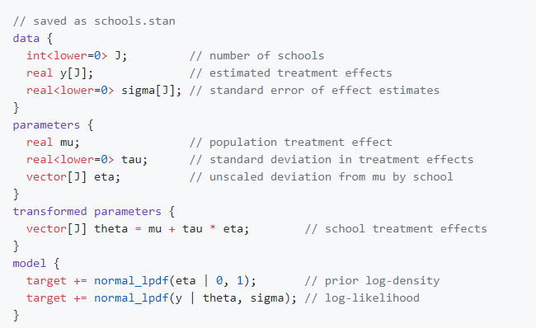
Sample code and data types
Each block is defined within {}
Each line of code ends with ;
Comments with //

Slide 9
Sample code and data types
Every variable used in a Stan program must have a declared data type
Two primitive data types:
A) For continuous values: real B) For integer values: int
Two matrix-based data types:
A) vector[M] B) row_vector[N] C) matrix[M,N]
Any type can be made into an array type: array
Local variables may be provided with constraints: <lower=L>

Slide 10
Sample code and data types
If variable y has length >1, we need to provide the length of the variable
Different
syntax
constrain
Need to define the length of the vector as well.
Why bother with two data types?
Cannot do calculation
real*real[]
Available argument signatures for operator*:
real*real real * vector
Notes:
Then you may ask then we can set all vector as type vector. That does not work as well. Because many inputs and outputs of existed functions have set the type of input and out puts that are allowed.

Slide 11

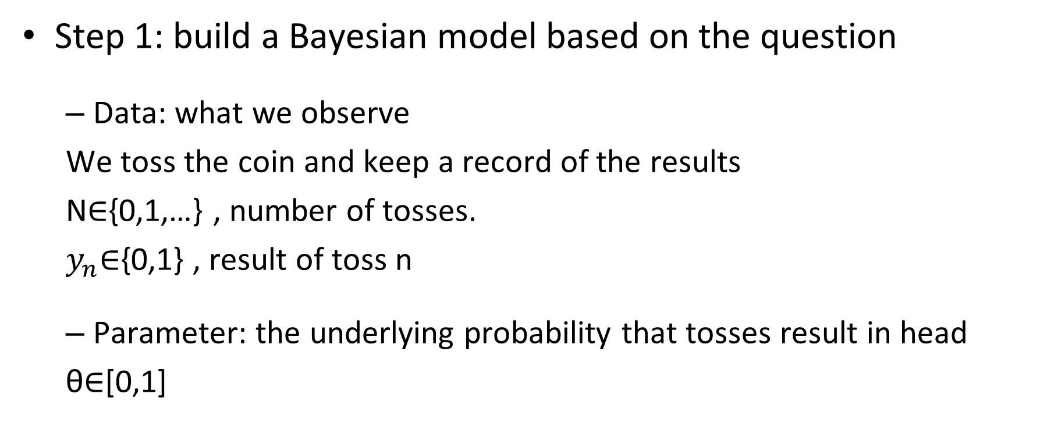
A basic statistic model: fair coin test
yn∈{0,1}yn∈{0,1}, result of trial n (known, modeled data)
Step 1: build a Bayesian model based on the question
Data: what we observe
We toss the coin and keep a record of the results
N∈{0,1,…} , number of tosses.
$y_{n}$∈{0,1} , result of toss n
Parameter: the underlying probability that tosses result in head
θ∈[0,1]

Slide 12

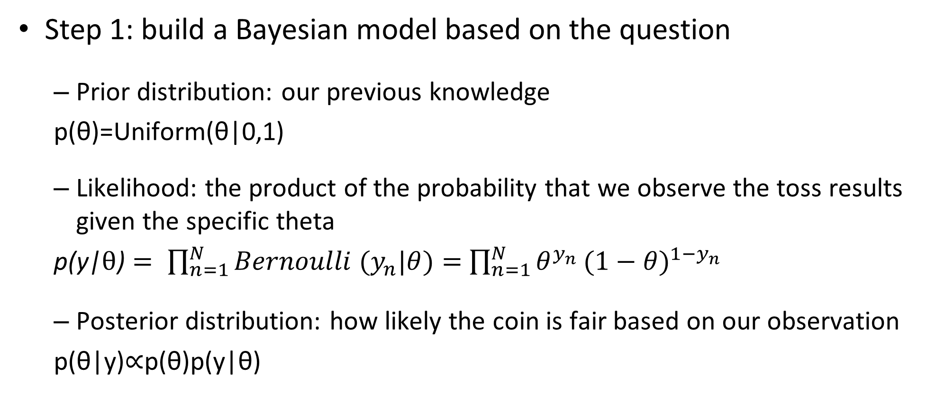
A basic statistic model: fair coin test
yn∈{0,1}yn∈{0,1}, result of trial n (known, modeled data)
Step 1: build a Bayesian model based on the question
Prior distribution: our previous knowledge
p(θ)=Uniform(θ|0,1)
Likelihood: the product of the probability that we observe the toss results given the specific theta
$\text{p}\text{(}\text{y}\text{|}θ\text{)}= \prod_{n=1}^{N}{Bernoulli (y_{n}|θ)}=$ $\prod_{n=1}^{N}{θ^{y_{n}}}({1−θ)}^{1−y_{n}}$
Posterior distribution: how likely the coin is fair based on our observation
p(θ|y)∝p(θ)p(y|θ)

Slide 13
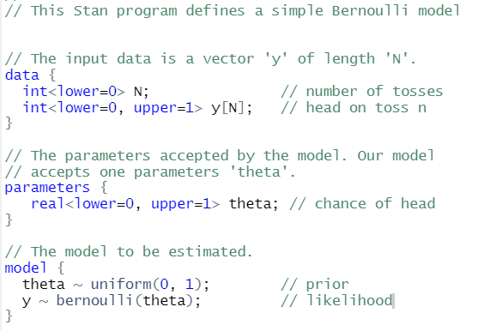
A basic statistic model: fair coin test
Step 2: create a stan program

Slide 14
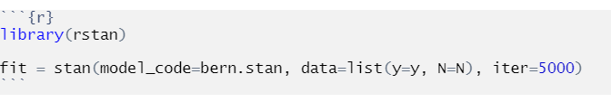
A basic statistic model: fair coin test
Step 3: feed the model with data
Step 4: compile Stan from R
Notes:
Here we need y and N

Slide 15

A simple mathematic model:
Stan has build-in function for solving ordinary differential equations (ODEs).
The function has a strict signature:
This function specify the variable types of inputs and outputs

Slide 16
An ODE example in Stan
Time, period of measurement t;
State, volumes in each compartment y;
Theta, parameters that the model estimates;
X_r, input fixed data;
X_i, input fixed data;
Notes:
Time is passed as the first argument as real
The second argument is the initial state, can be passed as either vector or real but need to be consistent with the variable type of function output
From the third can be user defined but needs to be consistent with the variable type in the data input chunk

Slide 17
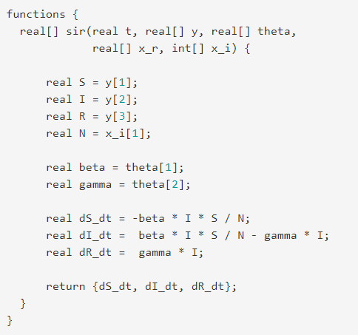
An ODE example in Stan
Define the name, input and output of the ODE function
The population in each compartment
S —— Susceptible
I —— Infectious
R —— Recovered (Immune)
Parameters of interests
beta —— transmissibility
gamma —— rate of recovery

Slide 18
An ODE example in Stan
Equations of the ODE function:
Transitions between states
Output of the ODE function
Notes:
Stan provides two integrators:
ode_rk45(sir, y0, t0, ts, theta, x_r,x_i);
ode_bdf (sir, y0, t0, ts, theta, x_r,x_i);

Slide 19
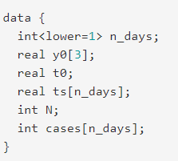
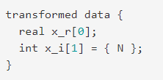
A simple mathematic model
Step 1: establish a series of ODE functions based on the question (see example above)
Step 2: declare fixed data in the data block and transform data
Must define the length of variable y or it will assume it is one
Notes:
X_r example: the rate of disease progression; the aging rate …

Slide 20
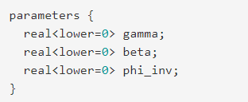
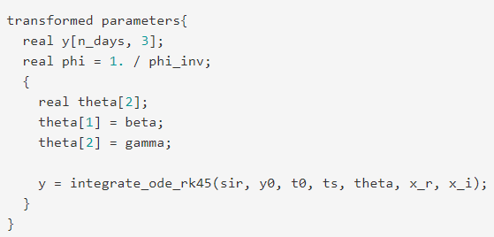
A simple mathematic model
Step 3: declare model parameters with constrains:
Step 4: transform parameters and integrate ODEs
A parameter that account for overdispersion in negative binomial distribution
Stan provides two integrators:
ode_rk45(sir, y0, t0, ts, theta, x_r,x_i);
ode_bdf (sir, y0, t0, ts, theta, x_r,x_i);

Slide 21
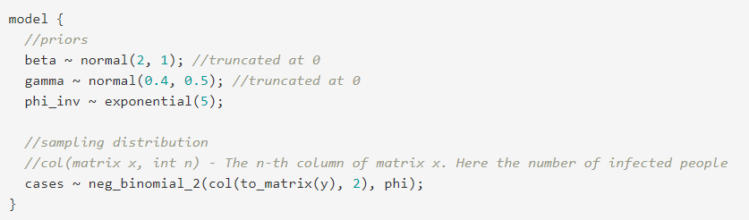
A simple mathematic model
Step 5: provide prior distributions and the likelihoods
This is an example from:
https://mc-stan.org/users/documentation/casestudies/boarding_school_case_study.html#introduction

Slide 22
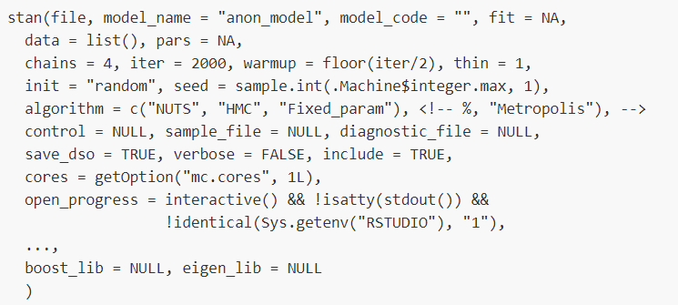
A simple mathematic model
Step 6: compile and sample the model from R

Slide 23
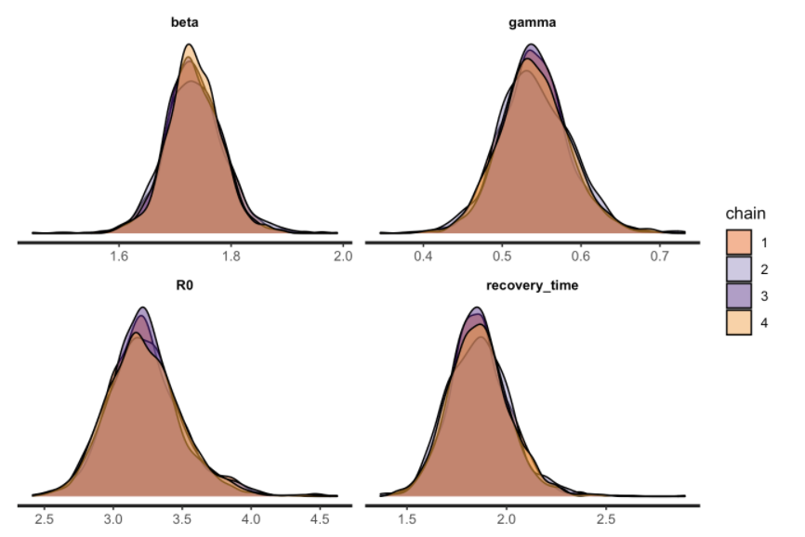
A simple mathematic model
Remember to check inference for convergence:
Rhat is close to 1 (< 1.01)
print(fit_sir_negbin, pars = c('beta', 'gamma', "R0", "recovery_time"))
The marginal posterior densities of different chains largely agree with each other
stan_dens(fit_sir_negbin,
pars = c('beta', 'gamma', "R0", "recovery_time")
, separate_chains = TRUE)
https://mc-stan.org/users/documentation/case-studies/boarding_school_case_study.html#introduction

Slide 24
Optimization in Stan
Stan use maximum likelihood estimates (MLE) in the optimization function:
model = stan_model(model_code=bern.stan)
mle = optimizing(model, data=c("N", "y"))
print(mle, digits=2)

Slide 25
Acknowledgement
Marina Antillon
Maile Thayer Phillips
Ginny Pitzer

